Slide 1

By : Pankaj Poudel

Slide 2
Table of content
Recall
Difference between Git and Git Hub
Installing and configuring Git and Git Hub
Creating repositories in Git Hub
Git commands
Concepts of merging branching and fork
Uploading files to Git Hub

Slide 3
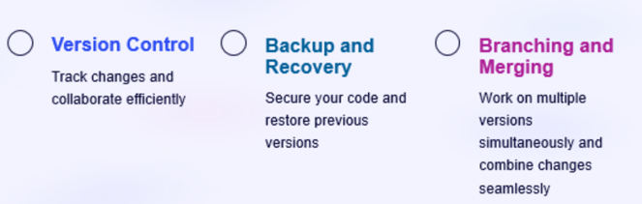
Recall from previous presentation:
What is Git ?
Git is a distributed version control system to track changes in source code. It allows multiple developer to work together to provide optimal solution.
Why to use Git?

Slide 4
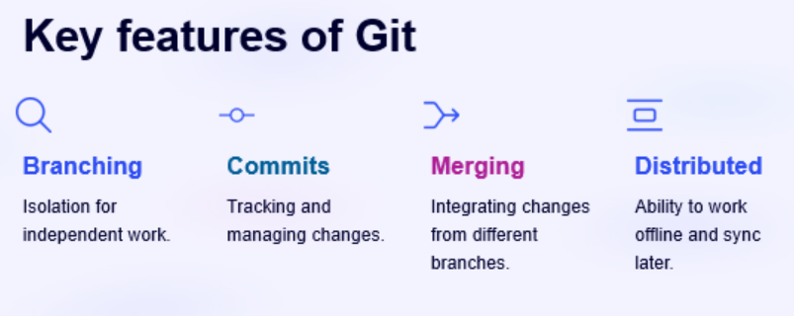

Slide 5
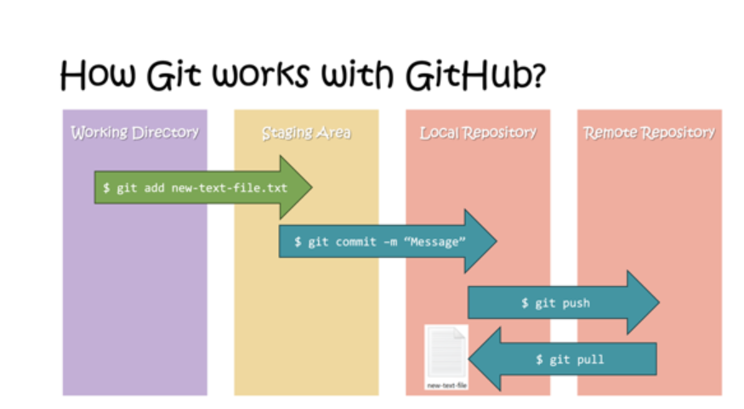

Slide 6
Is there any difference between
Git and Git Hub?

Slide 7
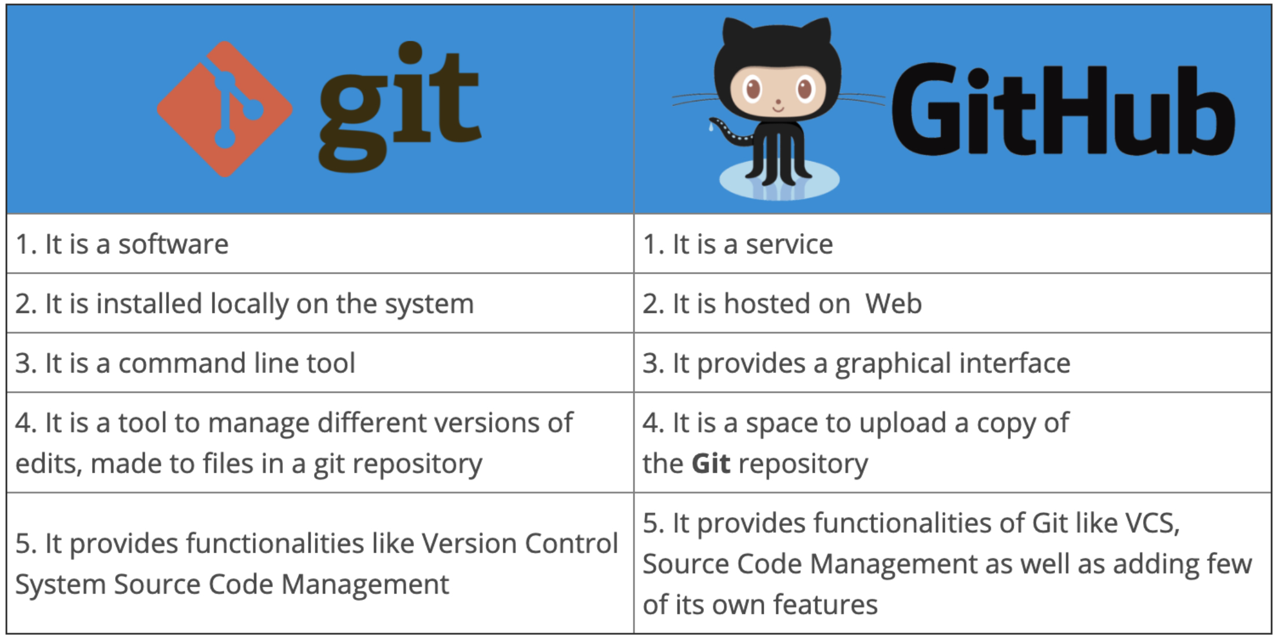
Yes and here it is:

Slide 8
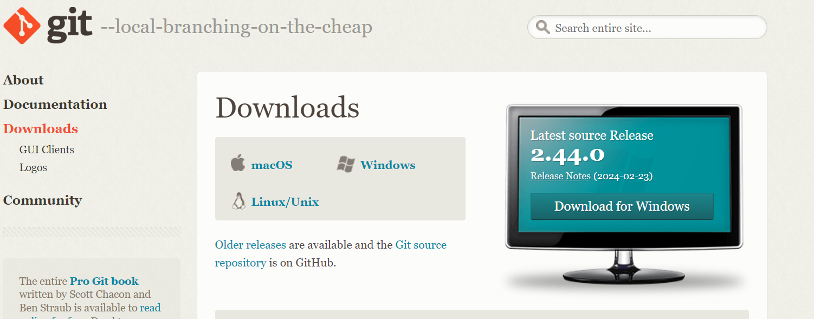
How to begin with it?
You can install Git via web browser following the below link
https://git-scm.com/downloads
I have windows so I select window you can chose that fits you
After selecting follow the prompts shown

Slide 9
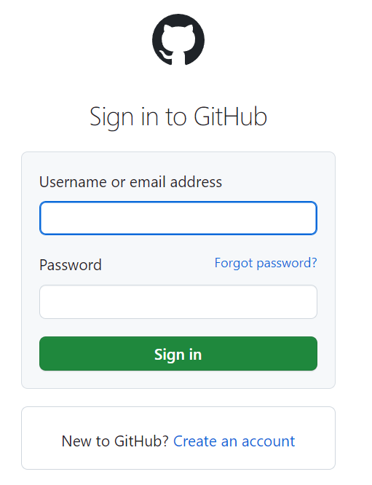
For Git Hub
You have to create account to use git hub just like other social media apps.
Follow the link below to create a account or sign in if you have already a account.
https://github.com/login?
To check Git is already in you pc or not use
git –version in your cmd

Slide 10
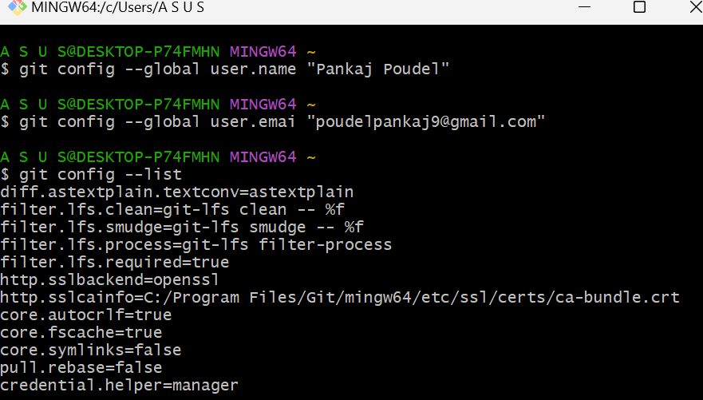
Configuration
Once we follow above steps then open Git that you have downloaded it’s time to configure it.
This is git bash you use that to configure

Slide 11
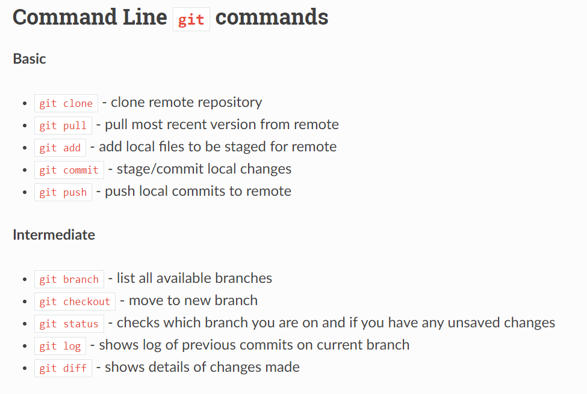
Why to configure git?
Configuring Git allows you to tailor the version control system to your specific needs. You will also know who is using Git to push changes to a repository.

Slide 12
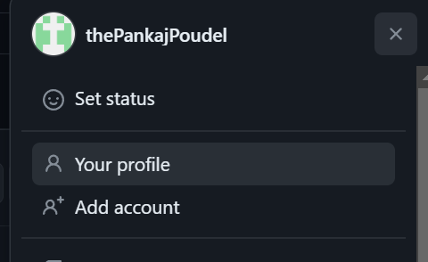
Using Git hub
After sign in in Git hub go to profile tab then follow the picture below.
When ever you feel lost in Git Hub you can go through profile tab.
Profile Icon
Repo = Repositories don’t get confused.
To create a new repositories click here
Select new to create new repo or choose existing rep

Slide 13
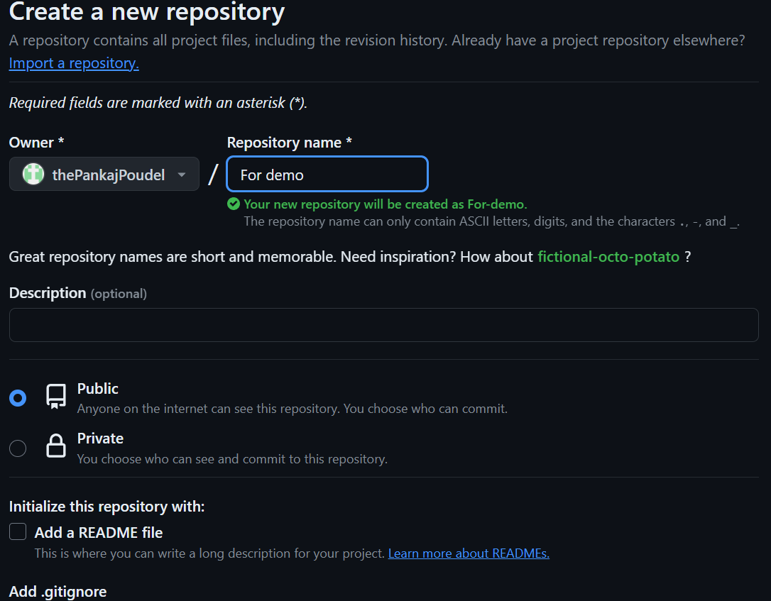

Slide 14
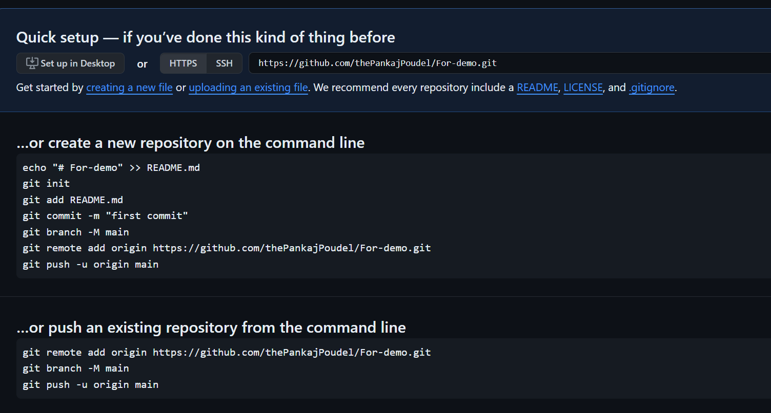

Slide 15
Now you created a Git hub repo its time to do some project and upload there.
Let us understand the command first.
Clone and Status Clone – cloning a repo on your local machine from remote machine.
git clone <-link of your repo ->
Status – displays the state of the code
git status
Remote refers to the git hub websites server. Local refers to your local computer.

Slide 16
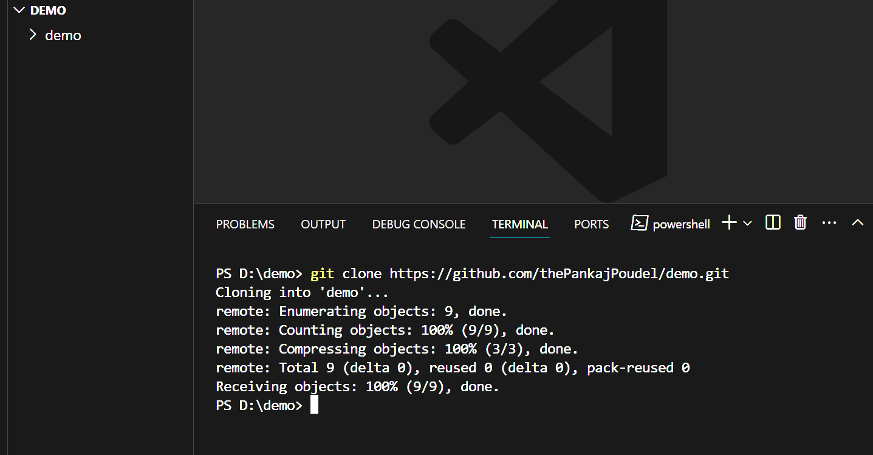
Clone:
Where to get that link?

Slide 17
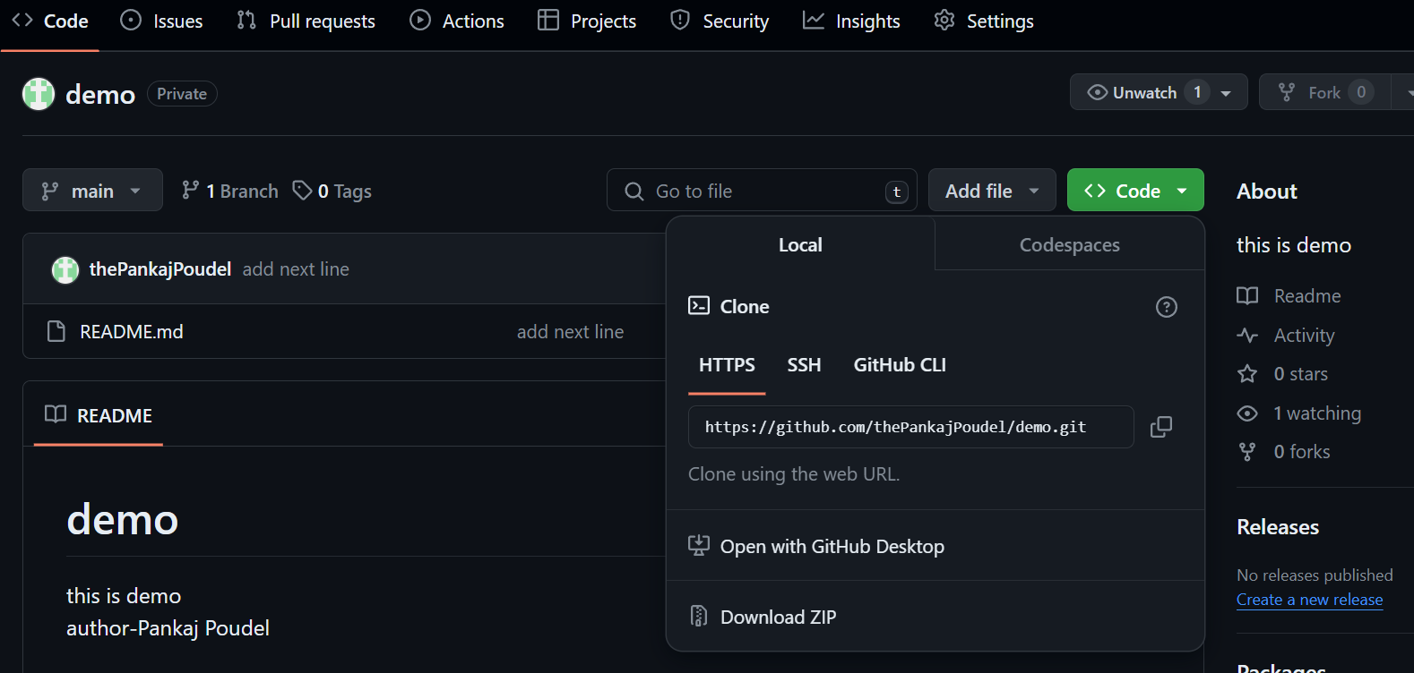
Where to get that link?
To get here click any repo you want to clone then you get below interface.
From here.
We use https most of the time because it is easy to use.

Slide 18
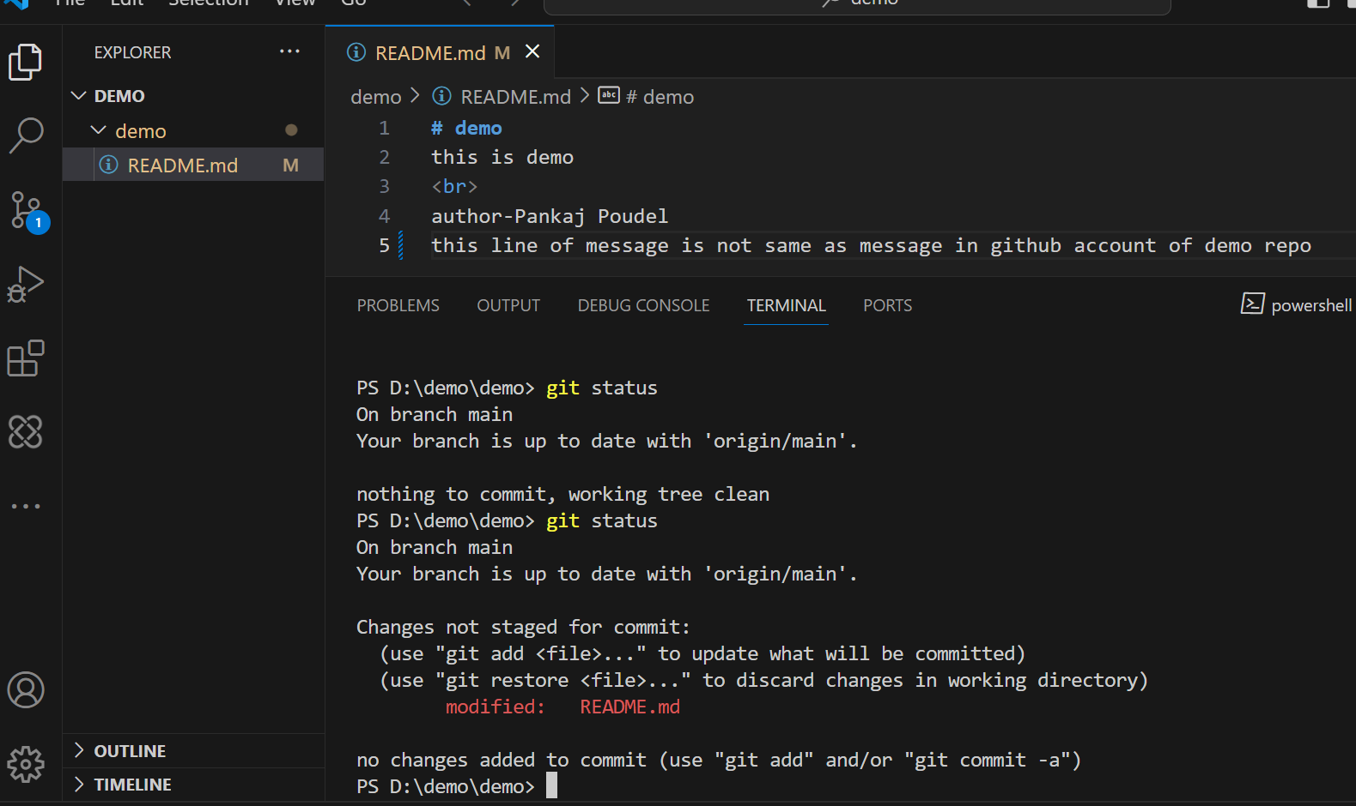
Status

Slide 19
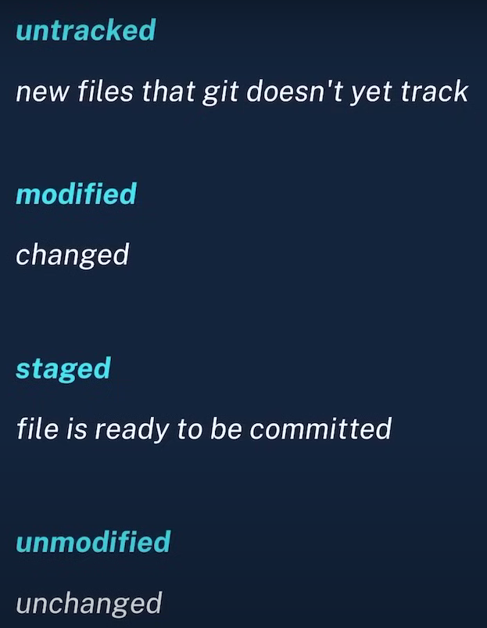
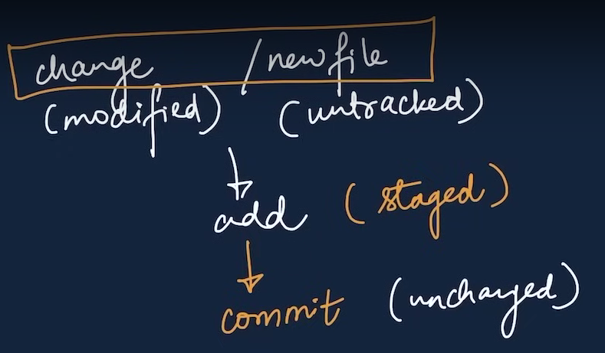

Slide 20
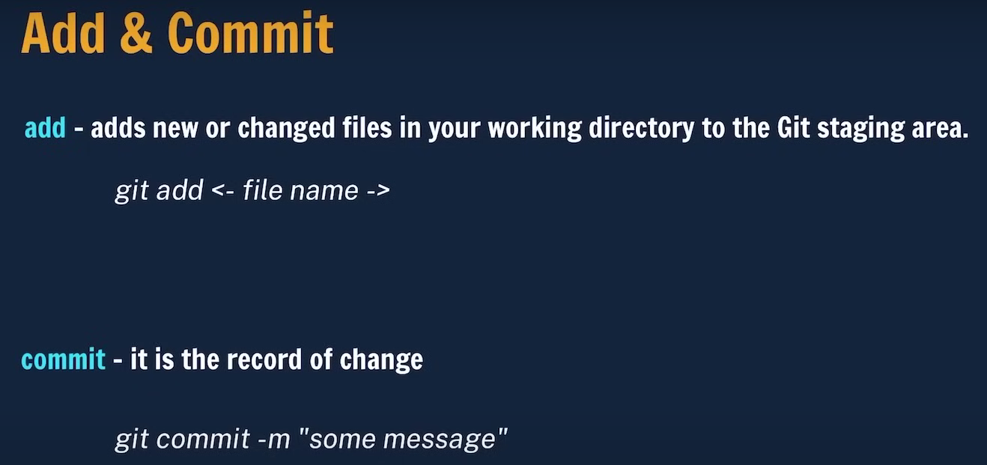

Slide 21
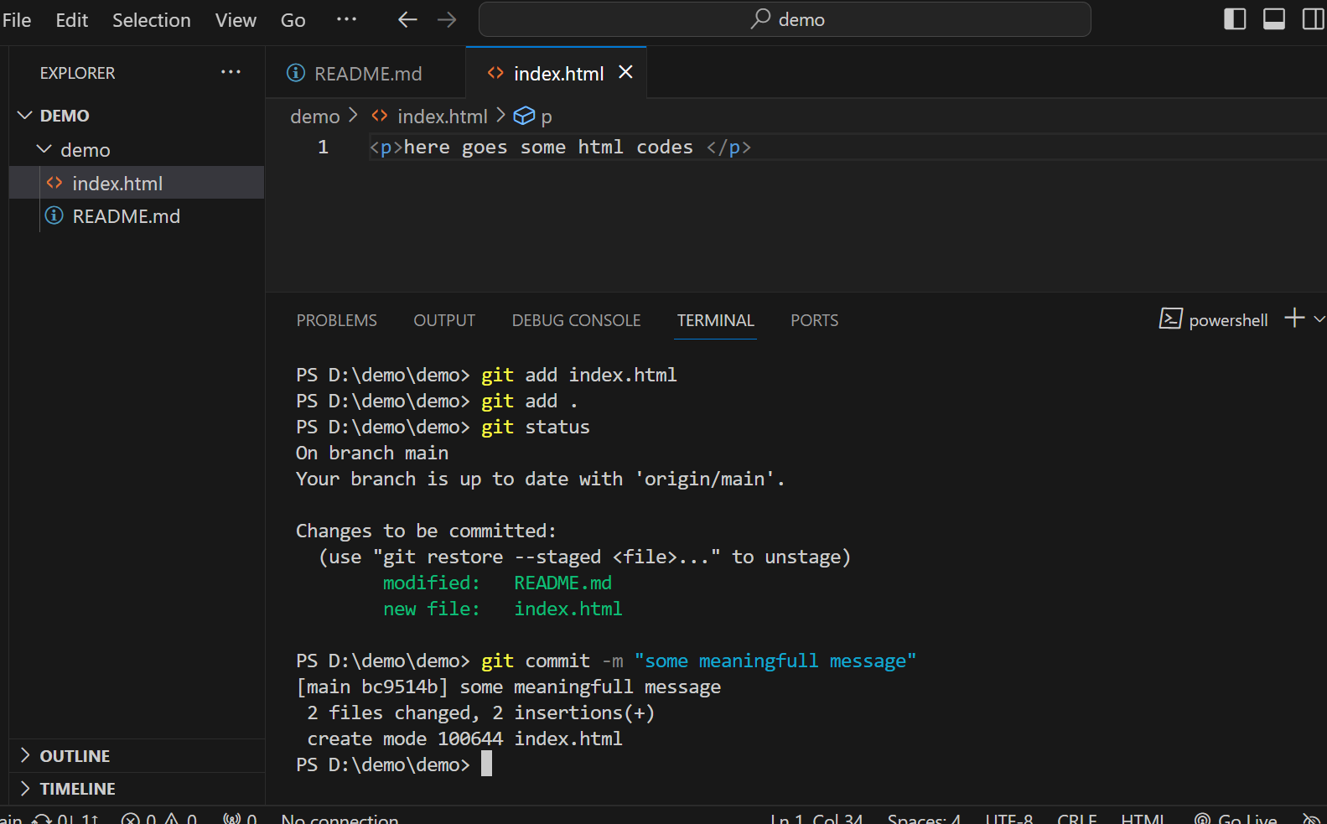

Slide 22
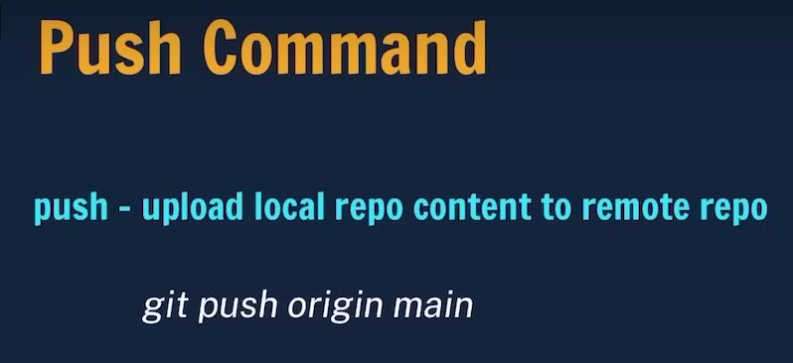
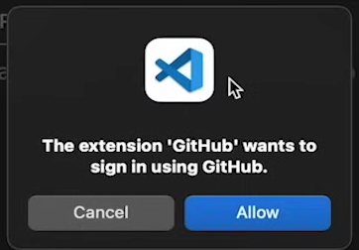
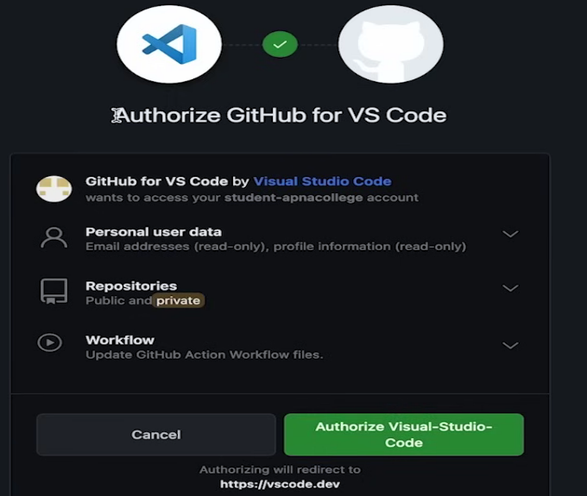
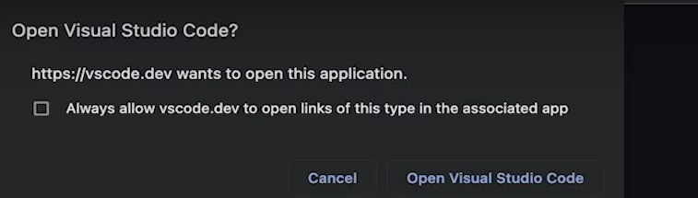
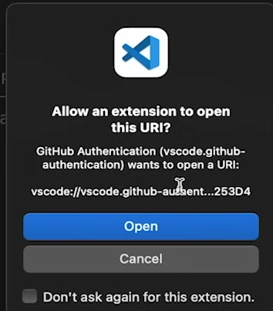
With out using this command our changes will not shown in repo at website
If you are using it first time VS Code may show pop ups
This is the flow When we click allow

Slide 23
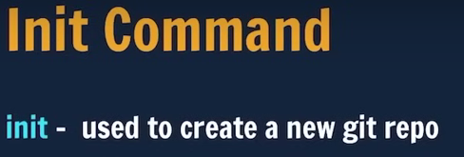
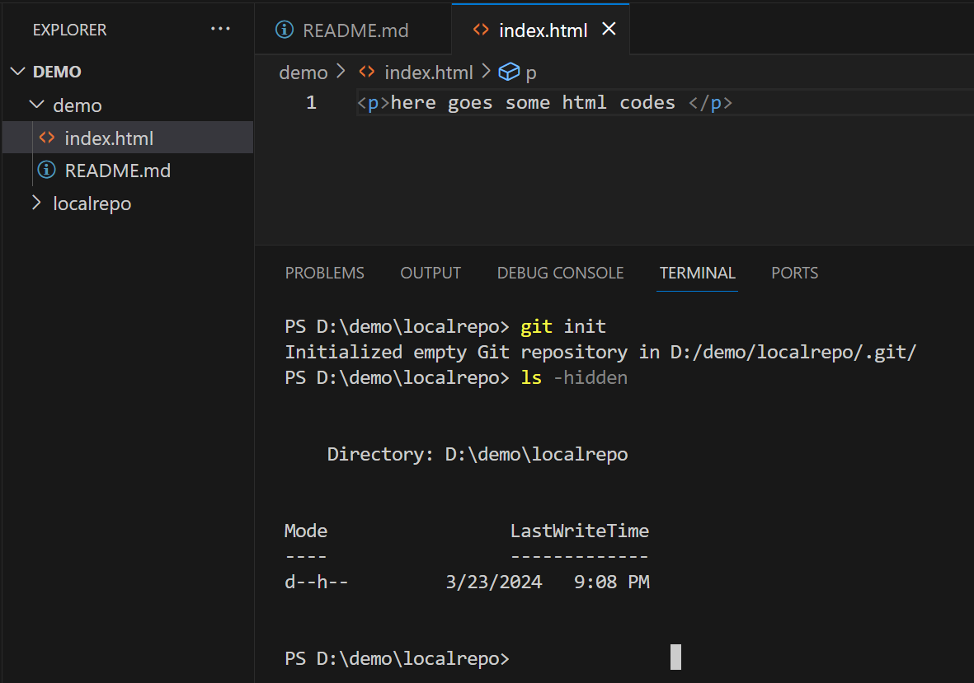
With out using it our file is not a git file.

Slide 24
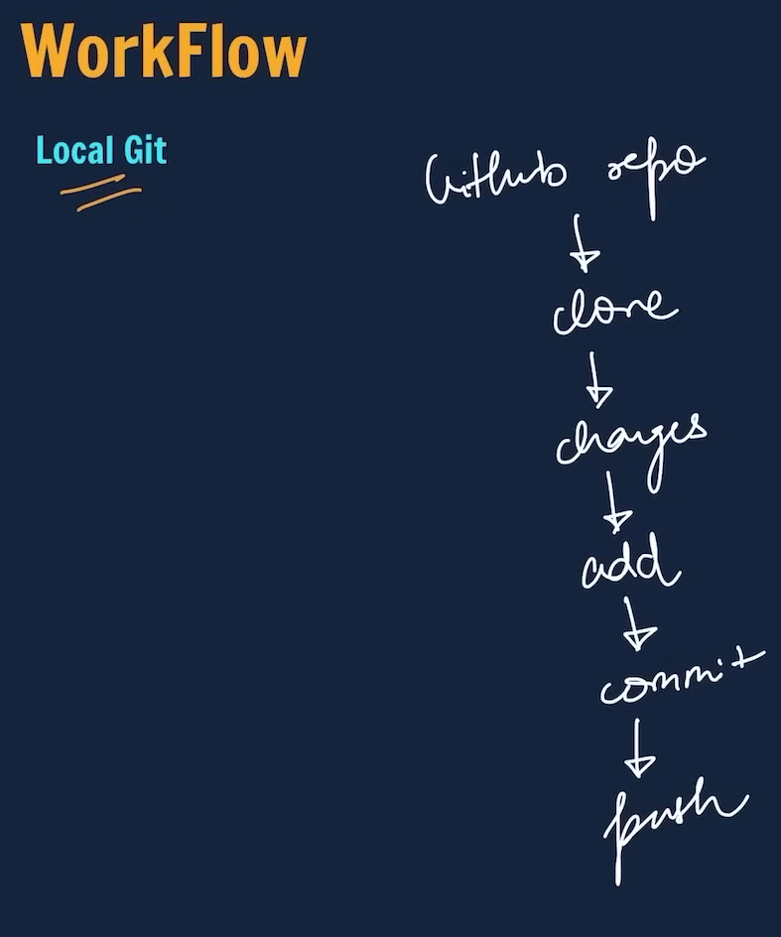

Slide 25
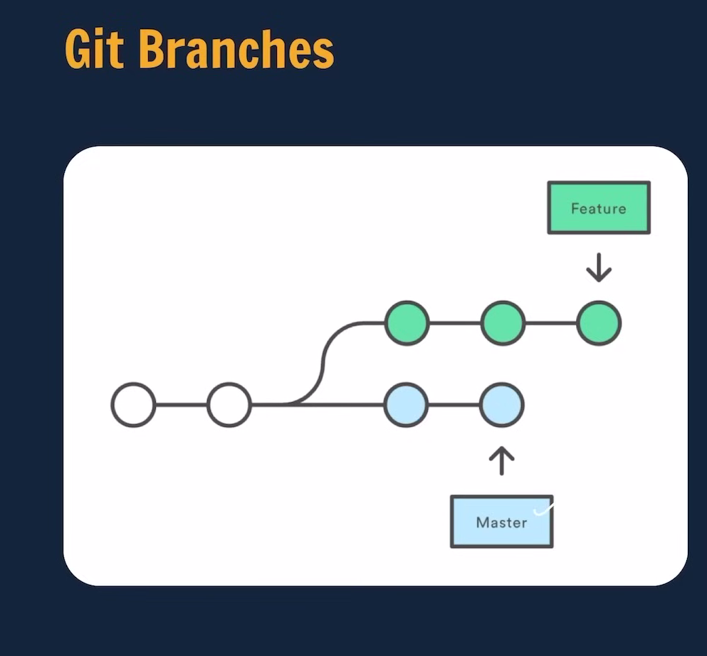

Slide 26
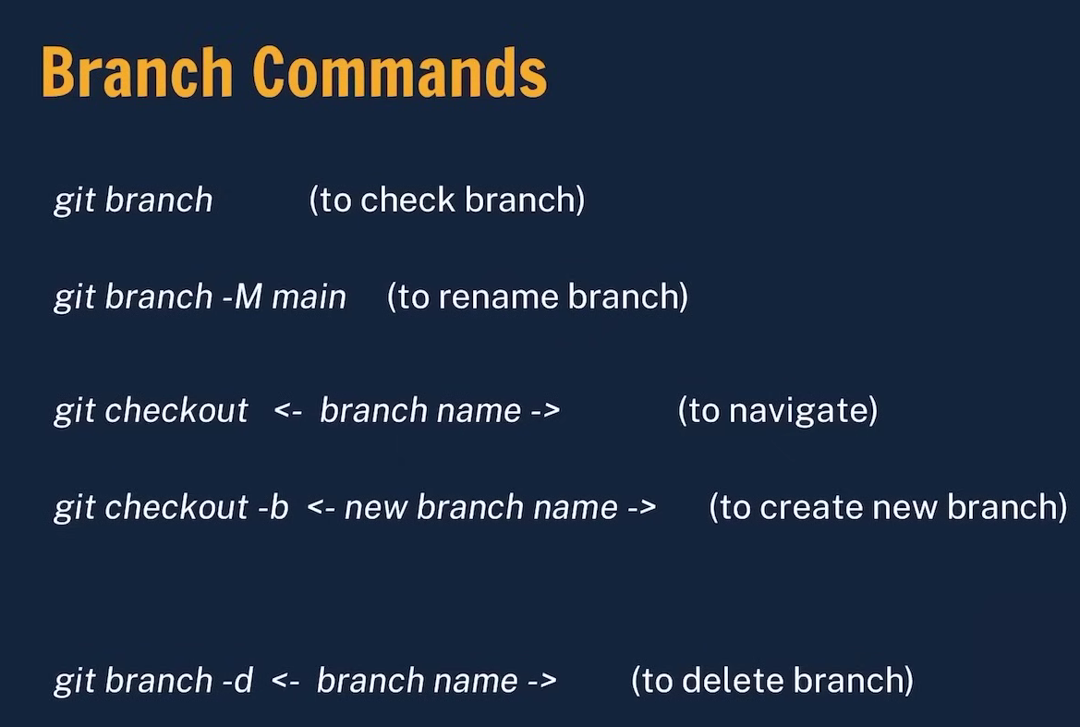

Slide 27
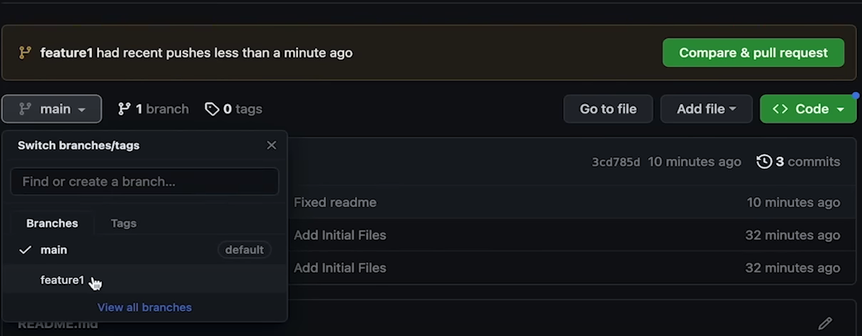

Slide 28
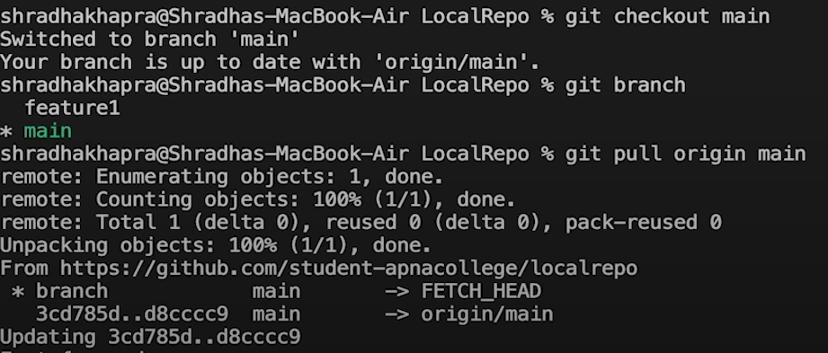

Slide 29
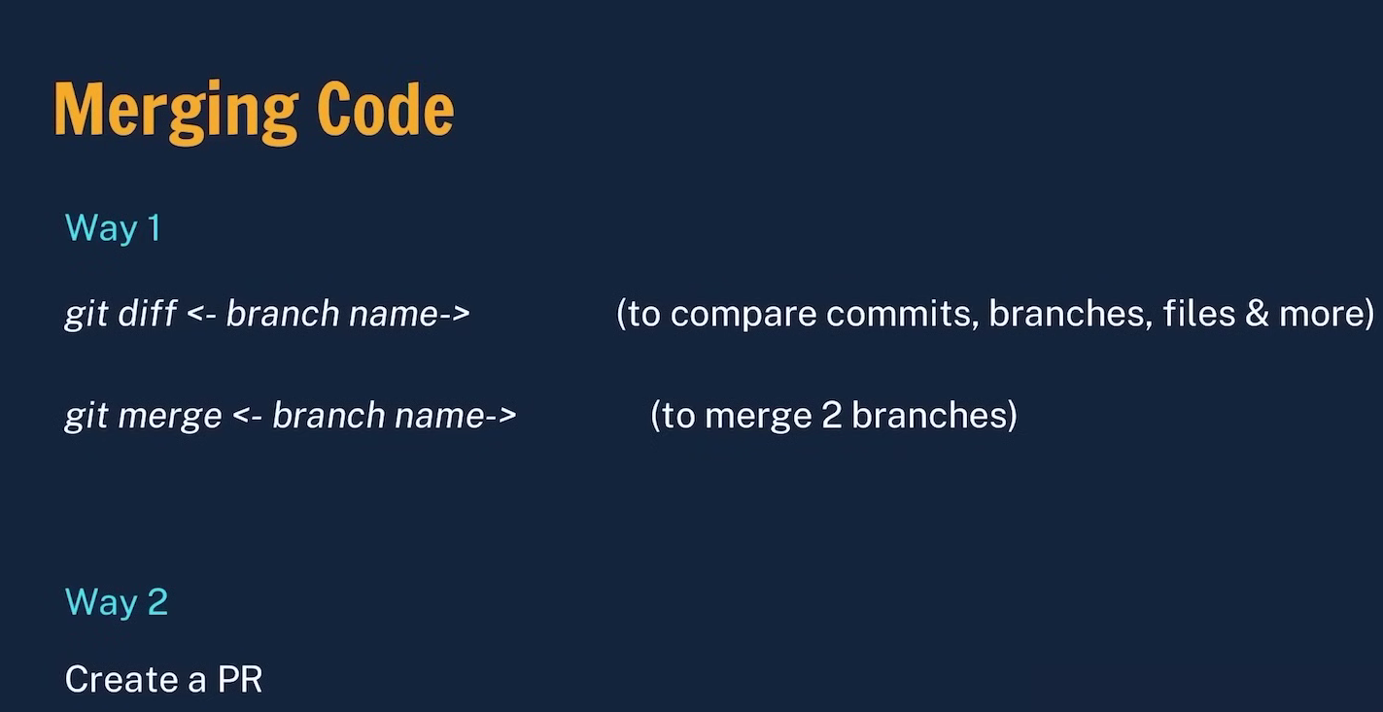

Slide 30
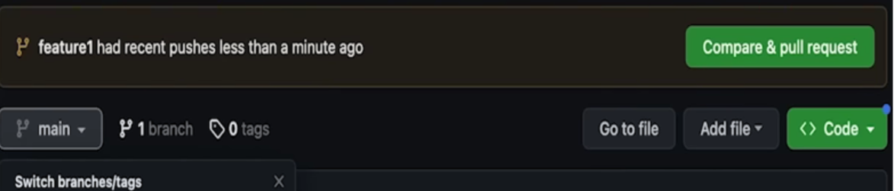
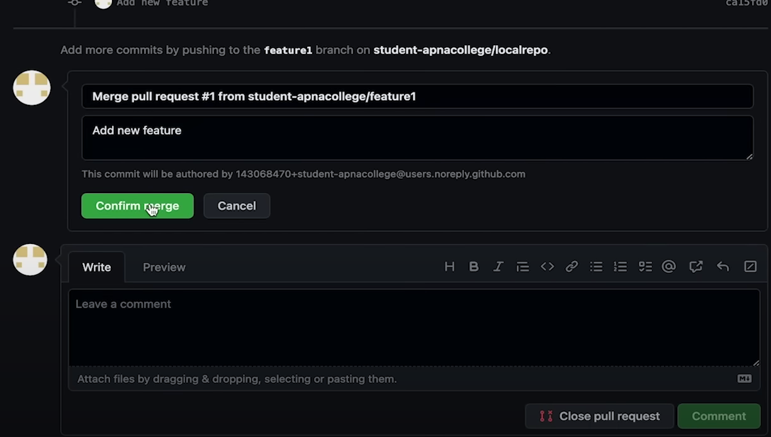

Slide 31

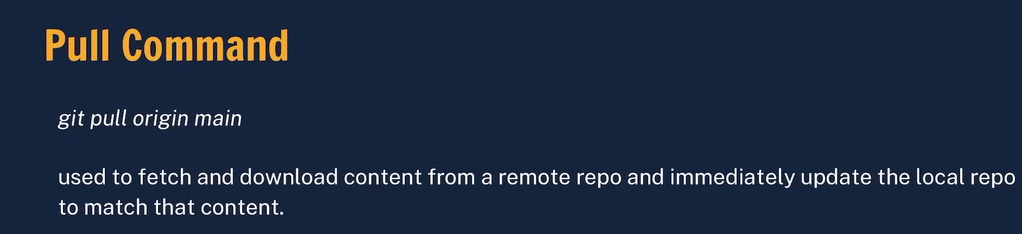

Slide 33

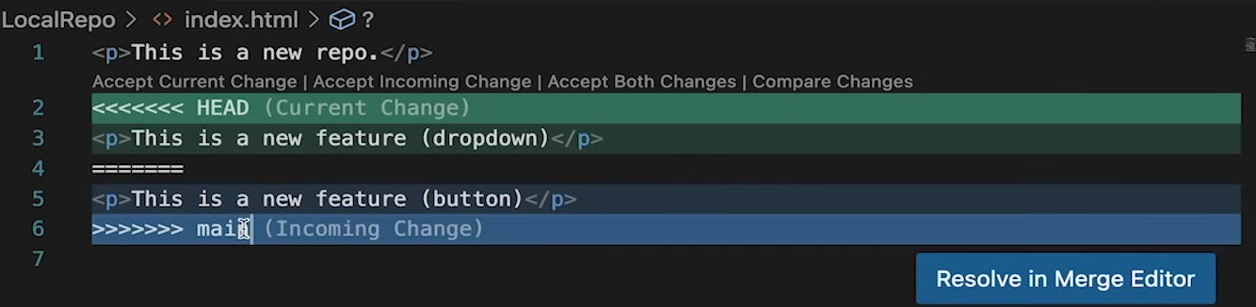
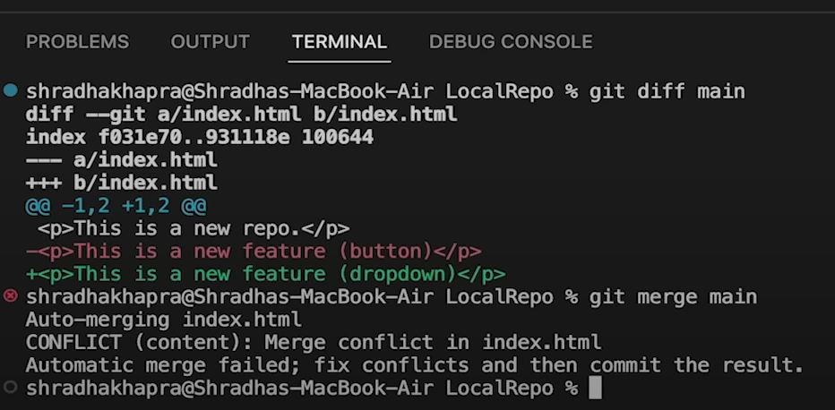

Slide 34
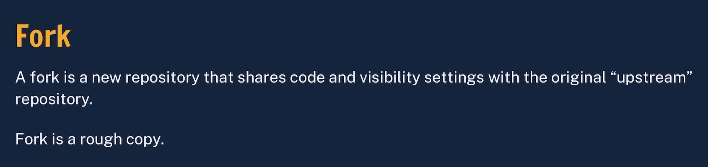
We can contribute in others project by using this.

Slide 35
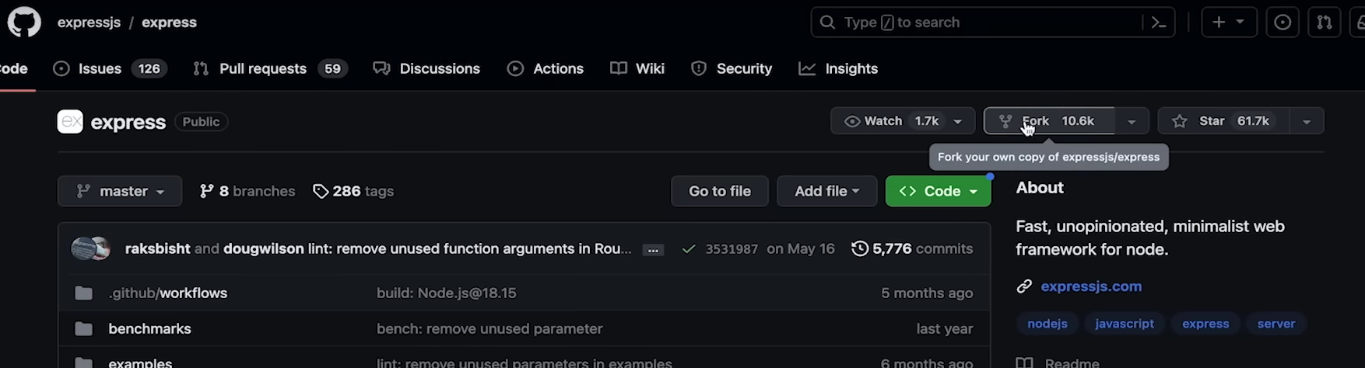

Slide 36
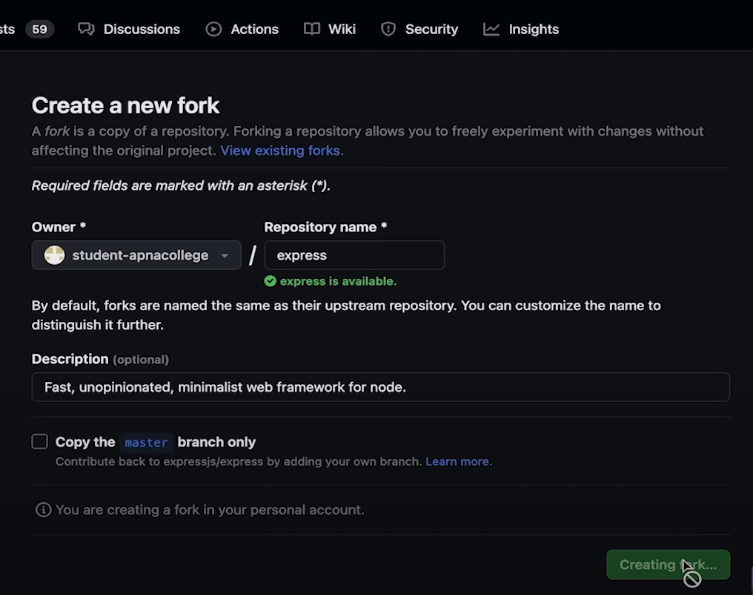

Slide 37
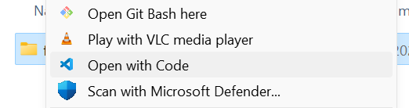
Uploading a file in Git Hub
Select a folder you want to upload

Slide 38
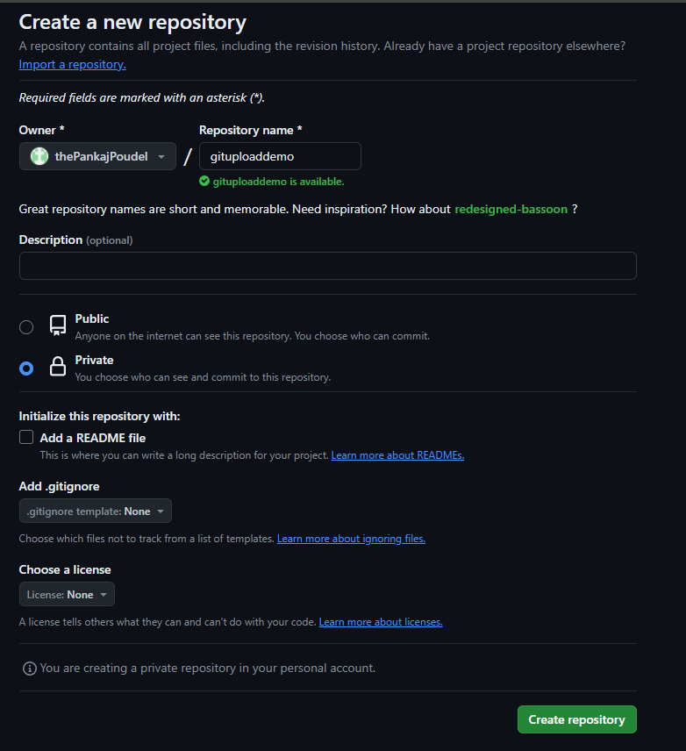

Slide 39
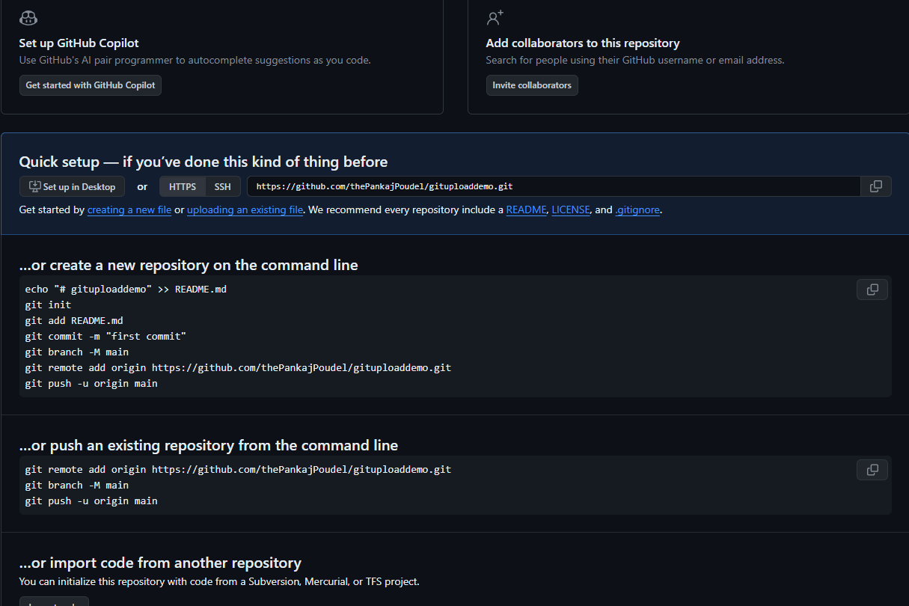

Slide 40
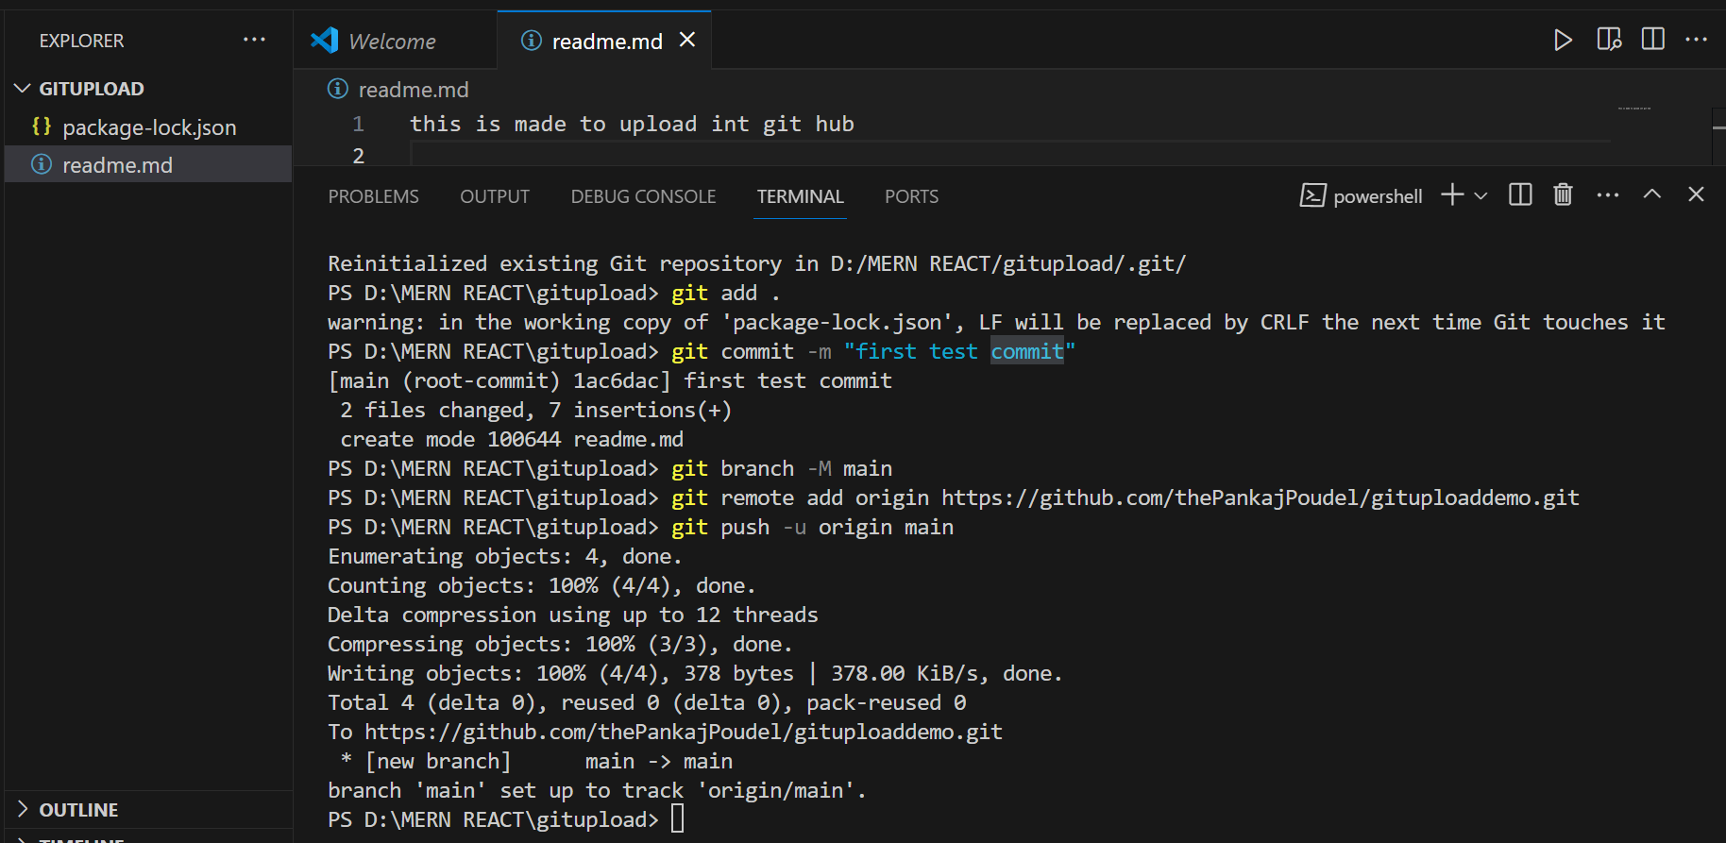

Slide 41
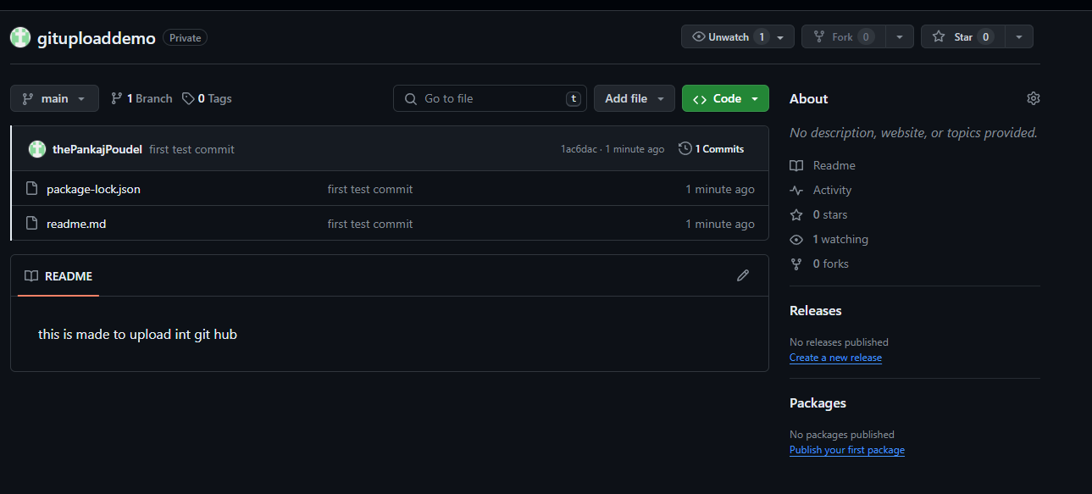

Slide 42
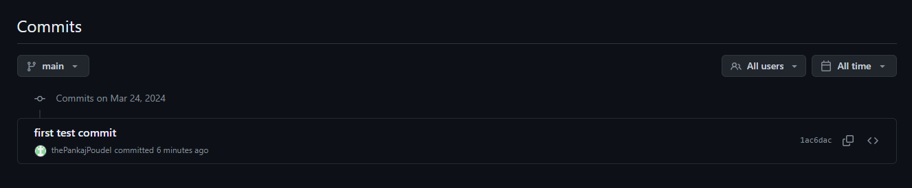

Slide 43

Question & Answer session
If you have any confusion or question on the topics that we are discussed above feel free to ask we try our best to guide you through your answers.
If you have any feedback for us then you can inform us we will acknowledge those and implement.

Slide 44
References
https://youtu.be/eGaImwD8fPQ?si=-dTUtIOI0X0Kp--w
https://youtu.be/Ez8F0nW6S-w?si=JVlQ6ip0lzoln6kS
https://docs.github.com/en/get-started/start-your-journey/hello-world
https://chat.openai.com/
https://youtu.be/gwWKnnCMQ5c?si=SkiXv4Dbkh0b8BJR
https://youtu.be/YbX_5FTOgL8?si=DreGb9idPMduJ3_N
https://training.github.com/downloads/github-git-cheat-sheet.pdf

Slide 45
Thank you
Collected by : Pankaj Poudel

